Slide 1
Auto Unit Test

Slide 2
Agenda
Introduction
Unit Test Framework
Mocking Framework
Test Coverage

Slide 3
Concepts Introduction
What is unit test?
It is a test for a unit
A unit is a class, method or a source block
It is a test for a program with another program
Functional test is not unit test
Usually, it does not depends on any external service or resource
What is auto test?
It is a kind of test that can be repeated automatically
It increase initial project investment
It reduce project cost in later phases
Usually, it is used to make sure there is no regression

Slide 4
Why It Is Not Used
Why there is no unit test in so many projects?
A software still works even though there is no unit test
Unit test is very expensive
Unit test is very time consuming
Unit test need additional technical skill
Implement unit test for legacy system is very difficult
The benefit is not so much until most of the sources are covered by unit test cases which means an big investment

Slide 5
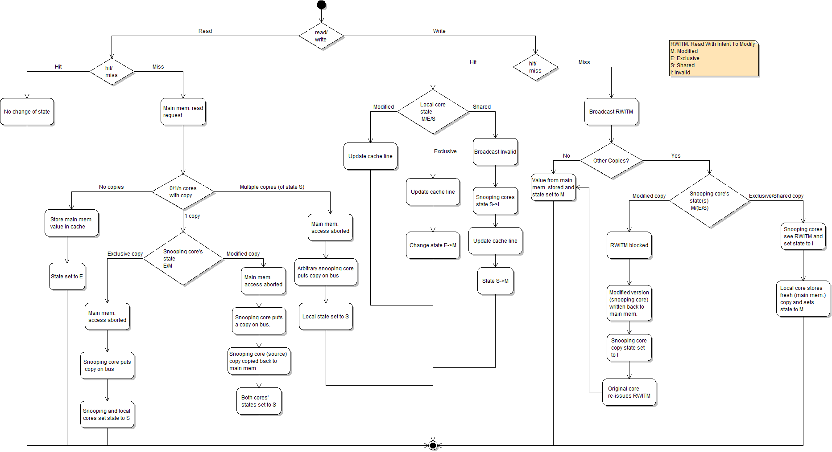
Why It Should Be Used
Why unit test should be done?
The only one solution for a complicated problem is splitting it into small cakes

Slide 6
Why It Should Be Used
Why unit test should be done? (Continue)
It is easy to make sure all sources have been covered
It increase quality
It reduce cost(if it is automated)
It save developer’s time since it provide an safety net (if it is automated)

Slide 7
Why It Should Be Used
Conclusions
Unit test must be automated
Unit test should cover most of the sources
Unit test increase your cost if
Project is very small and simple
Expected result is quick and dirty
Unit test save your cost if
Project is complex and last for long time
Expected quality is very high

Slide 8
UT vs FT
Can we replace auto unit test with auto functional test?
It is feasible technically
but not cost effective

Slide 9
UT vs FT
Functional test depends on a lots of resources
Preparation for functional test is very expensive
UI
Program 1
Table 4
Program 2
Program 3
Table 1
Table 2
Table 3
SMTP

Slide 10
UT vs FT
Some branches cannot be executed until many criteria is true
It is very difficult to design the testing data for it
All have been tested except this branch

Slide 11
UT vs FT
Functional test cases are very fragile
If a common program is changed all test data/case of programs that depends on this common program may be impacted.
Program 1
Program 2
Common Program
Table 1
Table 2
Table 3

Slide 12
UT vs FT
If the test failed, it is easy to identify the root cause in unit test
The test for this unit failed

Slide 13
Testing Pyramid
Auto testing pyramid should looks like this
Systems can talk with each other.
End to end functions have been implemented properly.
SIT
Functions have been implemented properly
Functional Test
Unit Test
Implementation match the expectation of programmers

Slide 14
Agenda
Introduction
Unit Test Framework
Mocking Framework
Testing Coverage

Slide 15
How To Do UT
The most simple way to do UT is invoking the units that will be tested in a main() method
If there are 1000 UT test cases
Do we need 1000 main() method?
How to manage these test cases?
How to run all these test cases?
How to know how many of them failed?
UT framework is needed

Slide 16
JUnit
JUnit is one of the most popular java UT framework
You may download it from “junit.org”
Usually, it has been integrated in J2EE Eclipse

Slide 17
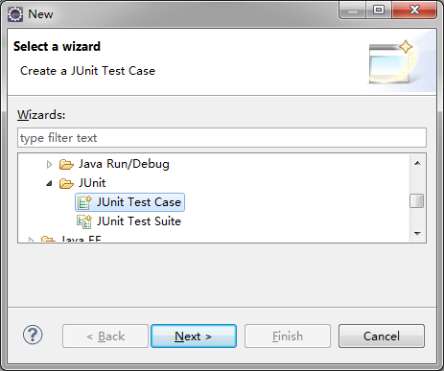
JUnit
Create a JUnit test case

Slide 18
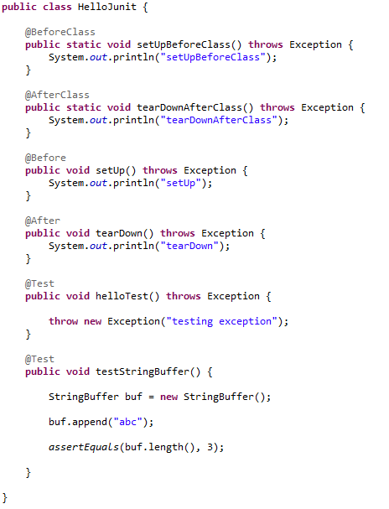
JUnit Test Case
Will be called before all cases in this class
Will be called after all cases in this class
Will be called before each cases in this class
Will be called after each cases in this class
Test case
Assert method

Slide 19
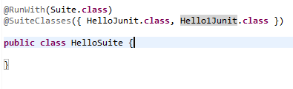
JUnit Test Suite
Group test classes into test suite

Slide 20
Agenda
Introduction
Unit Test Framework
Mocking Framework
Testing Coverage

Slide 21
Mocking
To isolate the unit under test from dependences, mocking is needed

Slide 22

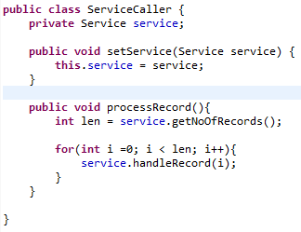
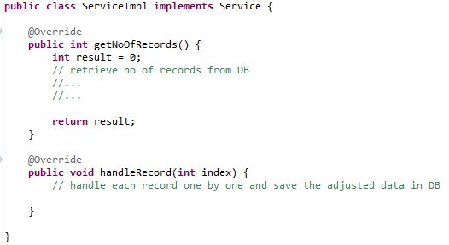
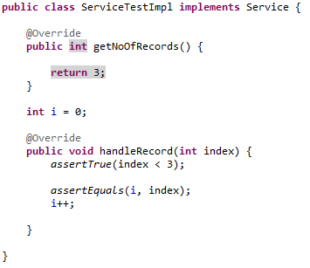
Simple Mocking
Class relationship
refer
Implement for test
Implement for production

Slide 23
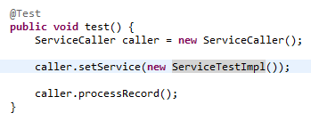
Simple Mocking
Test Case

Slide 24
Simple Mocking
Limitation of the simple mocking example:
It cannot mock private methods
It does not work if there no set method to inject the mocked object
It cannot mock static method
It cannot test private method
It does not work if the dependences do not implement an interface
Mocking framework is needed

Slide 25
JMockit
JMockit is an java mocking framework
Base on java.lang.instrument package
It replace product codes with mocking codes during test
Advantages of Jmockit
Classes do not implement interface or declared with final can be mocked
Static methods can be mocked
Private methods can be mocked or tested directly
No additional set method to inject the mocked object

Slide 26
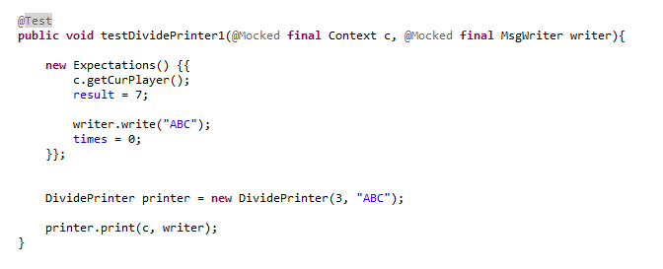
JMockit Sample
Mocked class
This implementation will replace production implementation because of @Mock
Let JMockit to verify how many times this method will be called.
Create the objects as usual. However, their implementation has bee modified.

Slide 27
JMockit Phases
Record
Record invocations before testing
Replay
Execute the sources are tested
Verify
Verify which invocation has been invoked

Slide 28
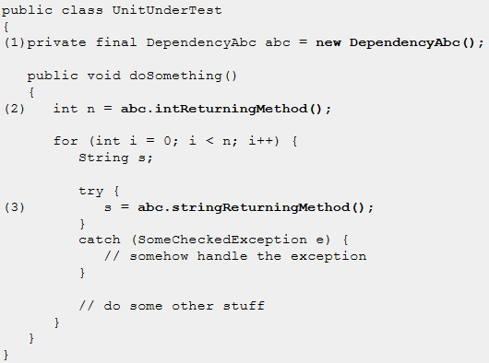
Mocked Objects
@Mocked

Slide 29
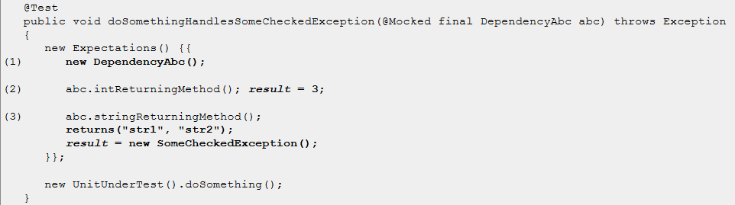
Mocked Objects
@Mocked(Continue)

Slide 30
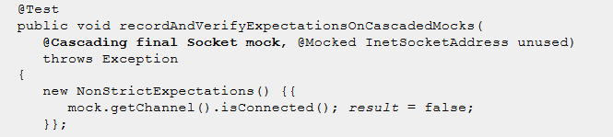
Mocked Objects
@Cascading

Slide 31
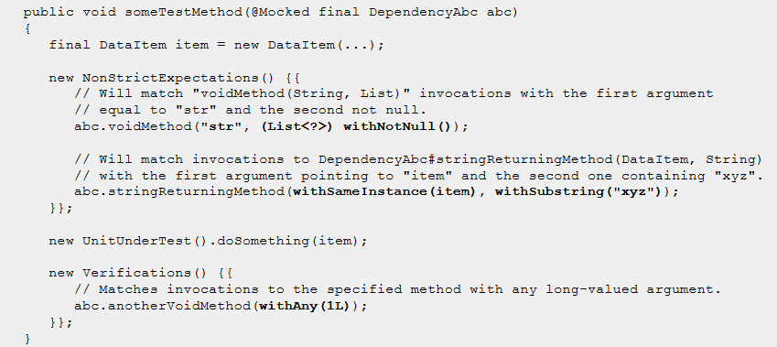
Matching Of Argument Values
Using the "with" methods

Slide 32
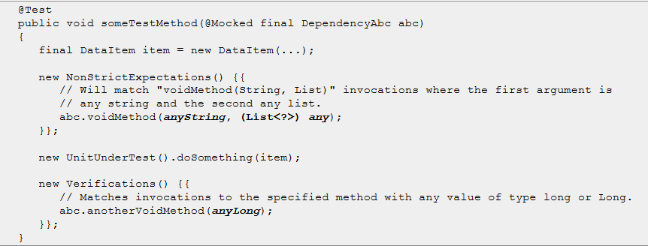
Matching Of Argument Values
Using the "any" fields

Slide 33
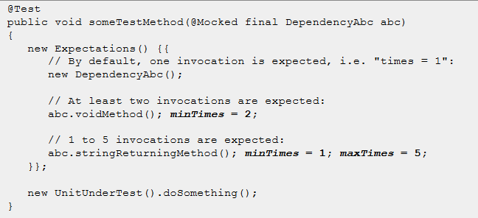
Invocation Count Constraints
Using “times”, “minTimes” and “maxTimes”

Slide 34
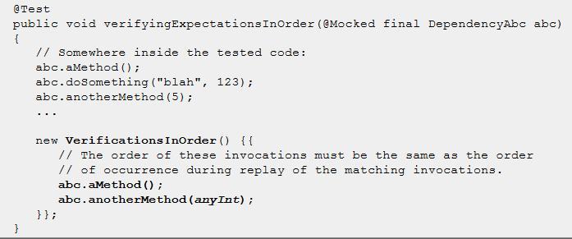
Explicit verification
Verification In Order

Slide 35
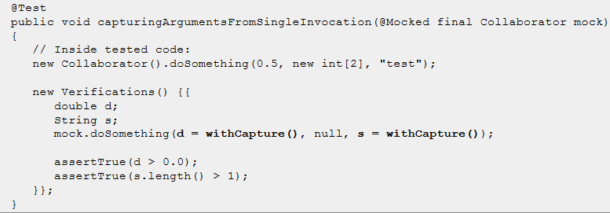
Explicit verification
Capture Invocation Arguments

Slide 36
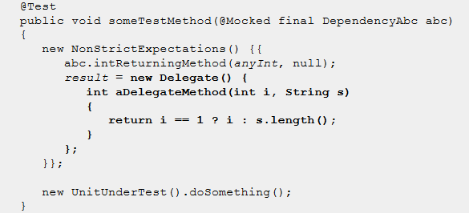
Dynamic Result
Using Delegate

Slide 37
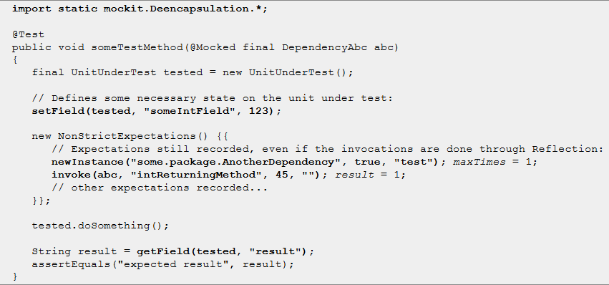
Access Private Info
Access Private Field, Method Or Constructor

Slide 38
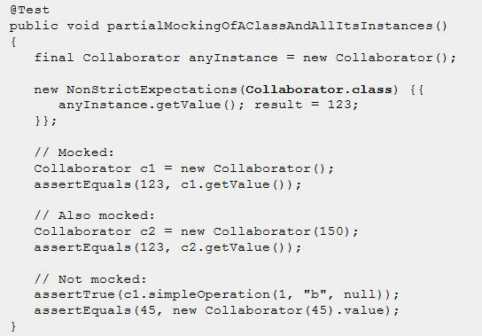
Partial Mocking
Dynamic partial mocking

Slide 39
Excerise
FizzBuzzWhizz
你是一名体育老师，在某次课距离下课还有五分钟时，你决定搞一个游戏。此时有100名学生在上课。游戏的规则是：
1. 你首先说出三个不同的特殊数，要求必须是个位数，比如3、5、7。
2. 让所有学生拍成一队，然后按顺序报数。
3. 学生报数时，如果所报数字是第一个特殊数（3）的倍数，那么不能说该数字，而要说Fizz；如果所报数字是第二个特殊数（5）的倍数，那么要说Buzz；如果所报数字是第三个特殊数（7）的倍数，那么要说Whizz。
4. 学生报数时，如果所报数字同时是两个特殊数的倍数情况下，也要特殊处理，比如第一个特殊数和第二个特殊数的倍数，那么不能说该数字，而是要说FizzBuzz, 以此类推。如果同时是三个特殊数的倍数，那么要说FizzBuzzWhizz。
5. 学生报数时，如果所报数字包含了第一个特殊数，那么也不能说该数字，而是要说相应的单词，比如本例中第一个特殊数是3，那么要报13的同学应该说Fizz。如果数字中包含了第一个特殊数，那么忽略规则3和规则4，比如要报35的同学只报Fizz，不报BuzzWhizz。

Slide 40
Agenda
Introduction
Unit Test Framework
Mocking Framework
Testing Coverage

Slide 41
Coverage Rate
How do you know how many sources have been tested?
JMockit provide coverage report
Coverage rates provided by JMockit report
Line
Path
Data

Slide 42
Coverage Report
How to active JMockit coverage report?
Place jmockit-coverage.jar at your classpath
Run your programs
How to config the coverage tool
-Dcoverage-outputDir: the folder for the report.
-Dcoverage-metrics: path/data/all

Slide 43
How To Use Coverage Report
Shall TL/Managers use this report to make sure team members have deliver sources that have been tested thoroughly?
No, they should not
Coverage report only can tell what has not been tested but cannot tell what has been tested properly
It will active observer anti-pattern in the team
Coverage report should be used by all team member to see what have not been tested

Slide 44
How To Use Coverage Report
Shall we always achieve 100% coverage rates?
The answer is “No.”
There are some sources do not need test. Such as value objects
The cost will be very high if all combinations of path are covered
The coverage rates should be defined base on the system nature or experience

Slide 45
Questions
Copyright © 2010 Accenture All Rights Reserved.
45
Notes:
45

